Slide 1
Challenge 1
Group 5
Iris, Dave, Ray, Aaron

Slide 2
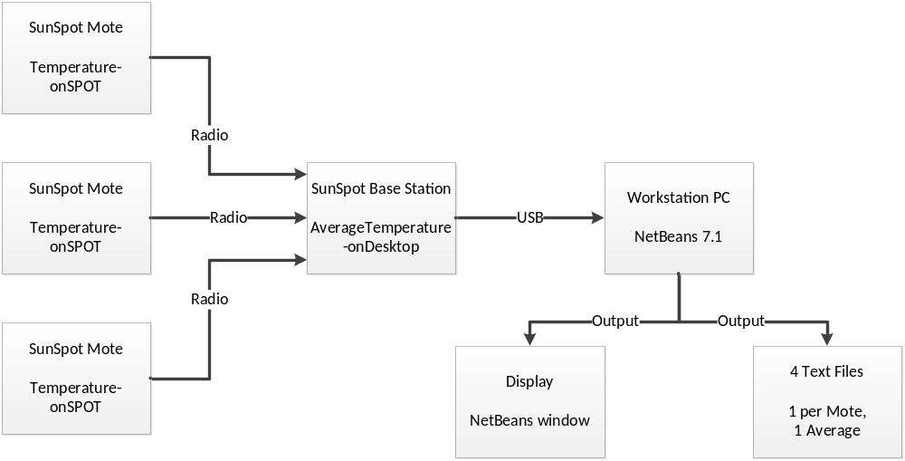
Architecture

Slide 3
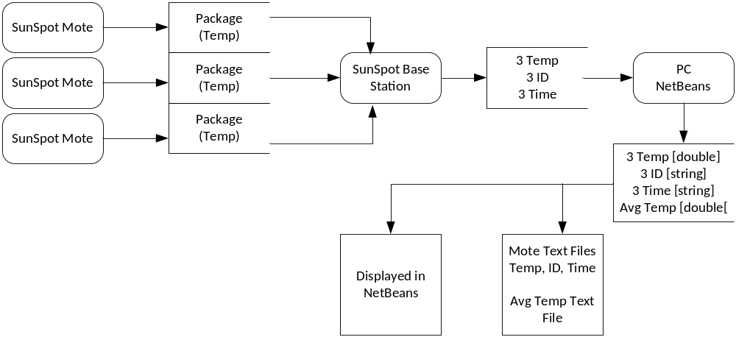
Data Flow

Slide 4
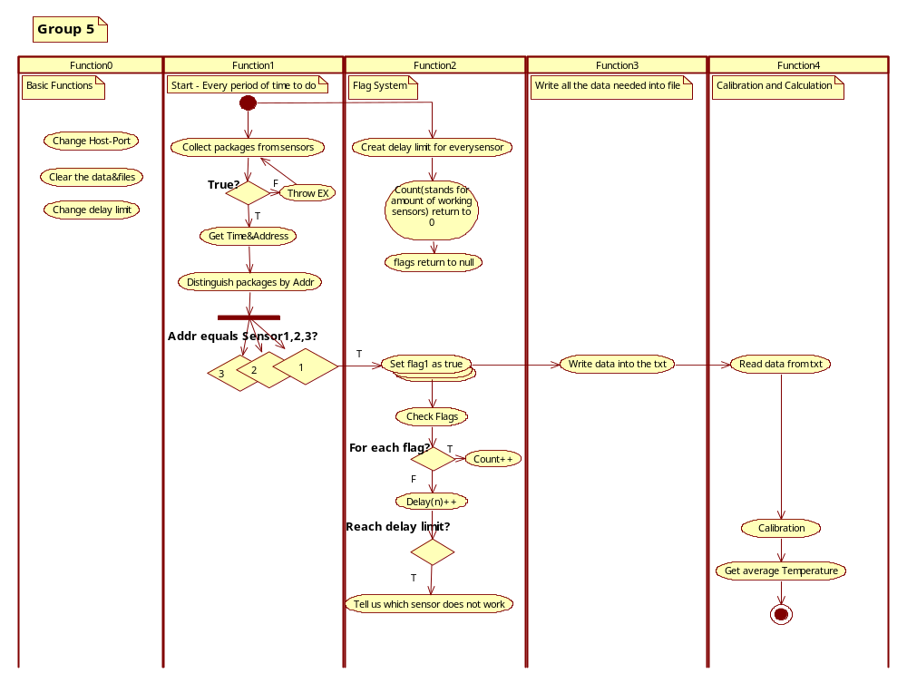
Work Flow

Slide 5
Demonstration of solution
See Laptop setup.

Slide 6
Main Code
rCon.receive(dg);
String addr = dg.getAddress(); // read sender's Id
long time = dg.readLong(); // read time of the reading
double val = dg.readDouble(); // read the sensor value
if ( addr.equals("0014.4F01.0000.359D"))
{
val1 = val;
this.printData(1, val1, fmt.format(new Date(time)));
this.writeToFile(f1, val1, fmt.format(new Date(time)));
flag1 = true;
}

Slide 7
Main Code
if ( flag1 == true && flag2 == true && flag3 == true)
{
averageTemp = this.getAverageTemp(val1,val2,val3);
System.out.println( "average temperater is "+ averageTemp +” F , time is " + fmt.format(new Date(time)));
this.writeToFile(f4, averageTemp, fmt.format(new Date(time)));
flag1 = false;
flag2 = false;
flag3 = false;
}

Slide 8
Main Code
public void writeToFile(File f, double val, String time) throws Exception{
try {
BufferedWriter output1 = new BufferedWriter(new FileWriter(f, true));
output1.write(new Double(val).toString());
output1.newLine();
output1.write(time);
output1.newLine();
output1.close();
}
catch (Exception e) {
System.err.println("Caught " + e + " while reading sensor samples.");
throw e;
}
}

Slide 9
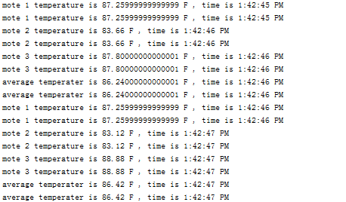
Sample of the Output

Slide 10
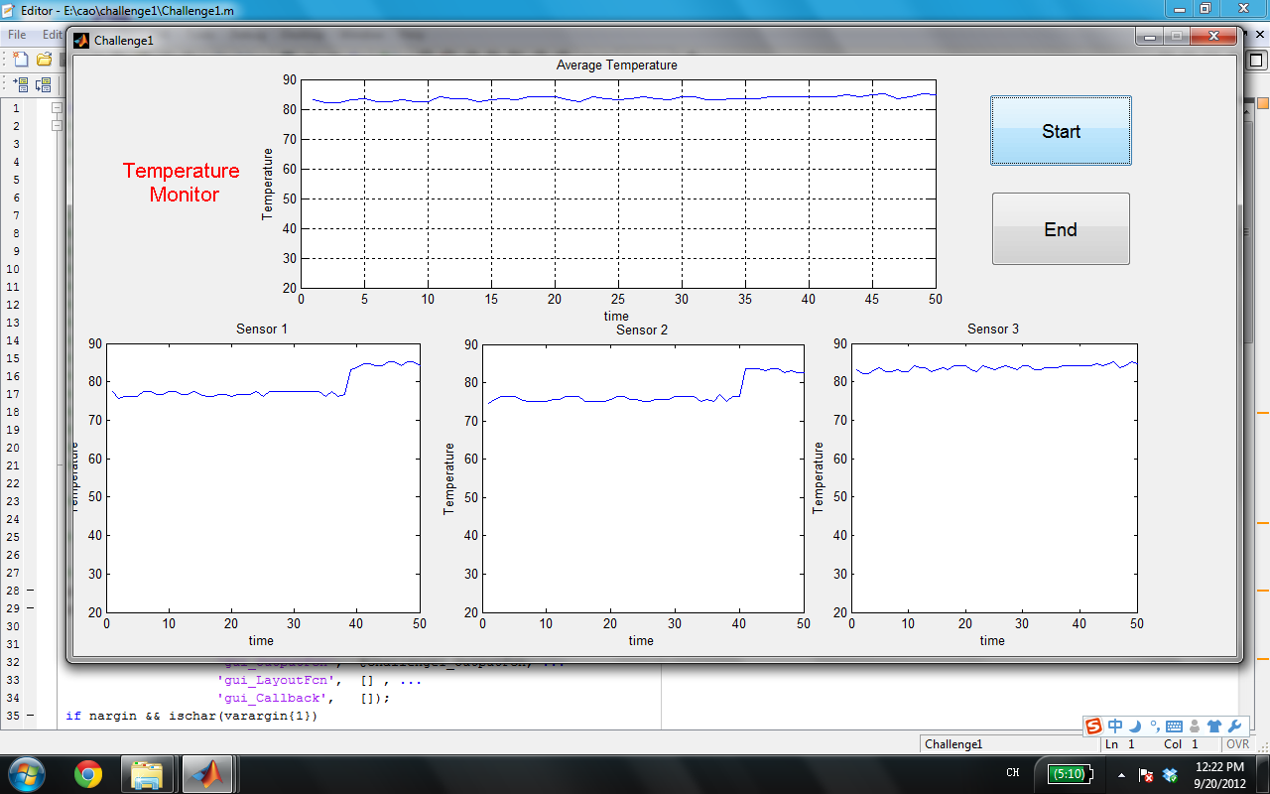
Graphic user interface in Matlab

